Slide 1
Artificial Intelligence for Poets

Slide 2
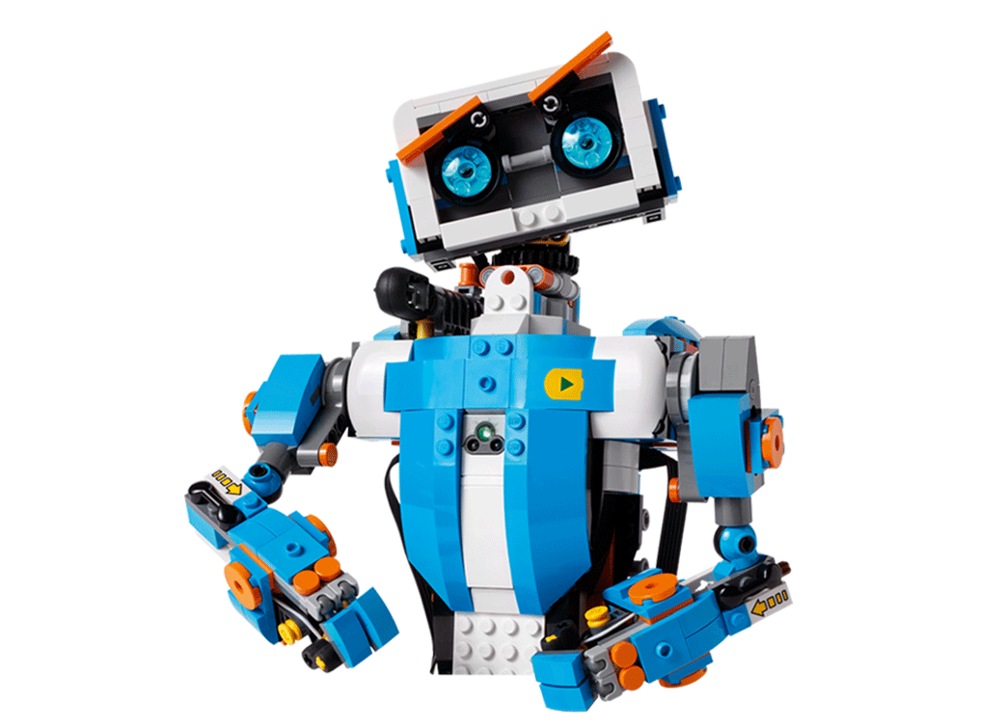
Agenda
Artificial Intelligence
Key AI components
How Machine Learning works?
Deep Learning and various network topologies
AI in production
AI at hardware level

Slide 3
Artificial Intelligence
1

Slide 4
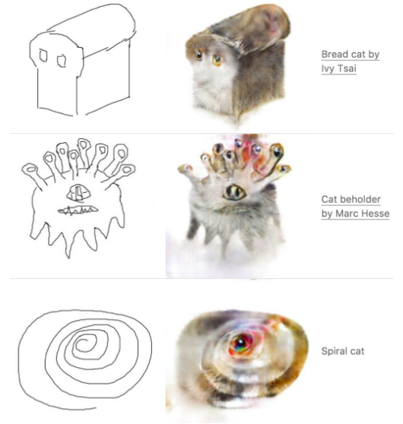
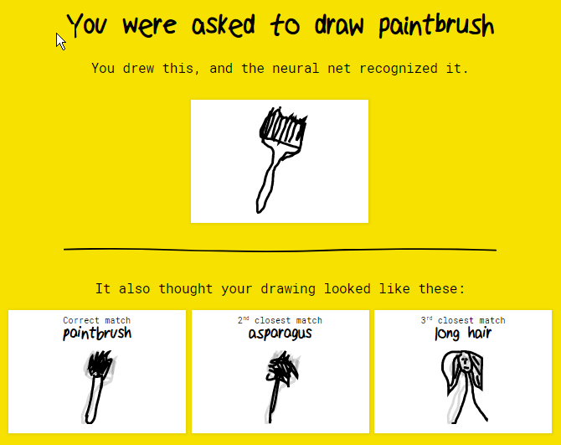
AI in action

Slide 5


Slide 6
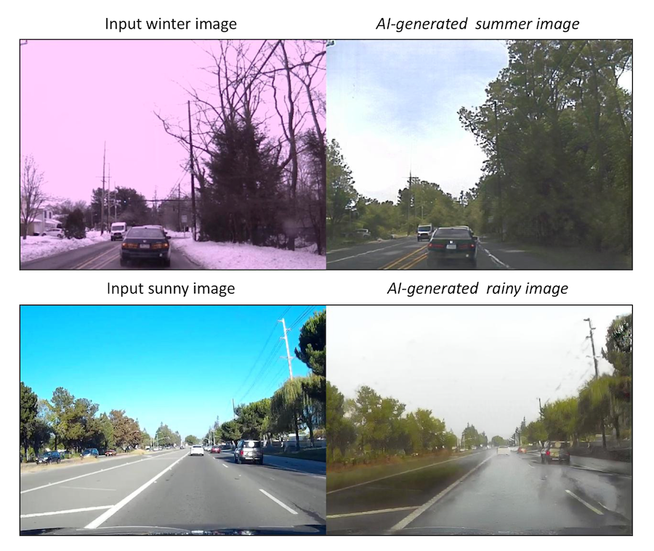
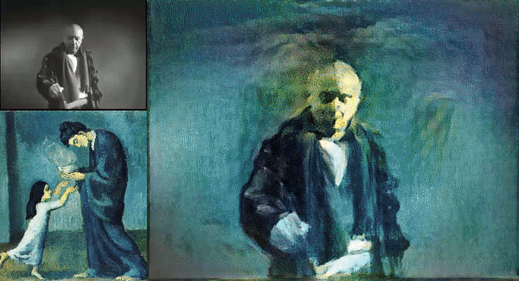
AI in action (style transfer)

Slide 7
What is Artificial Intelligence?
Artificial Intelligence is a set of algorithms that can perform tasks that require human cognitive abilities
Image Recognition
Natural Language processing
Complex enviroment interactions (eg. Games)

Slide 8
Key AI components
2

Slide 9
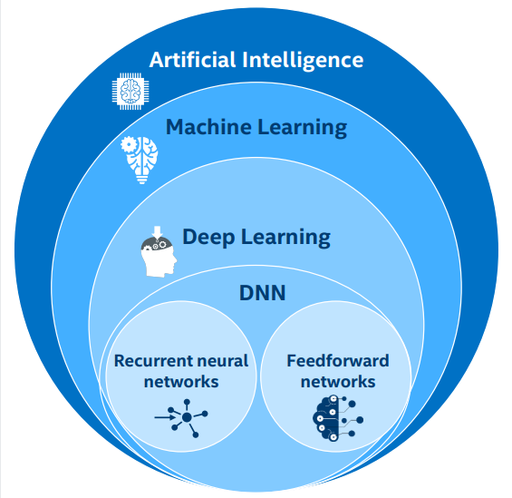



AI components
Artificial Intelligence Complete decision making system
Machine Learning: Systems, algorithms that are able to learn from data
Deep Learning:
Neural Network with multiple hidden layers

Slide 10
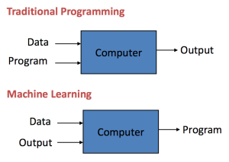
Coding vs. learning

Slide 11
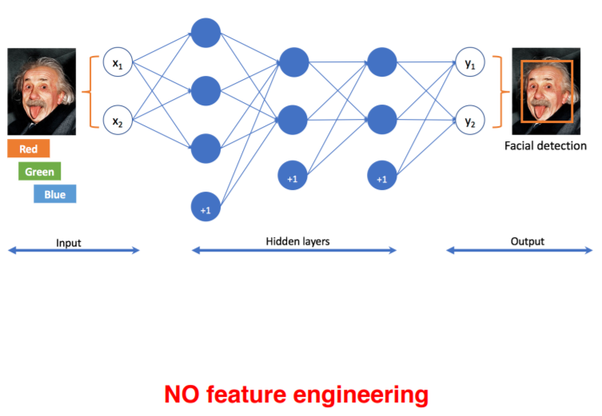
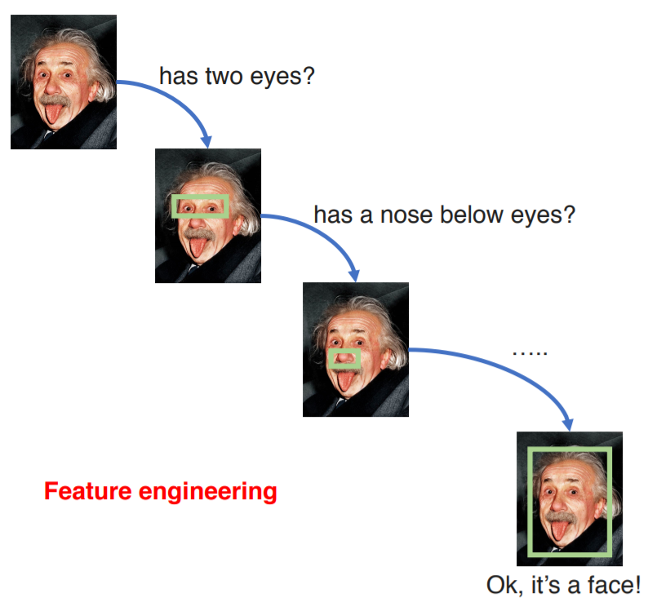
Coding vs. learning

Slide 12
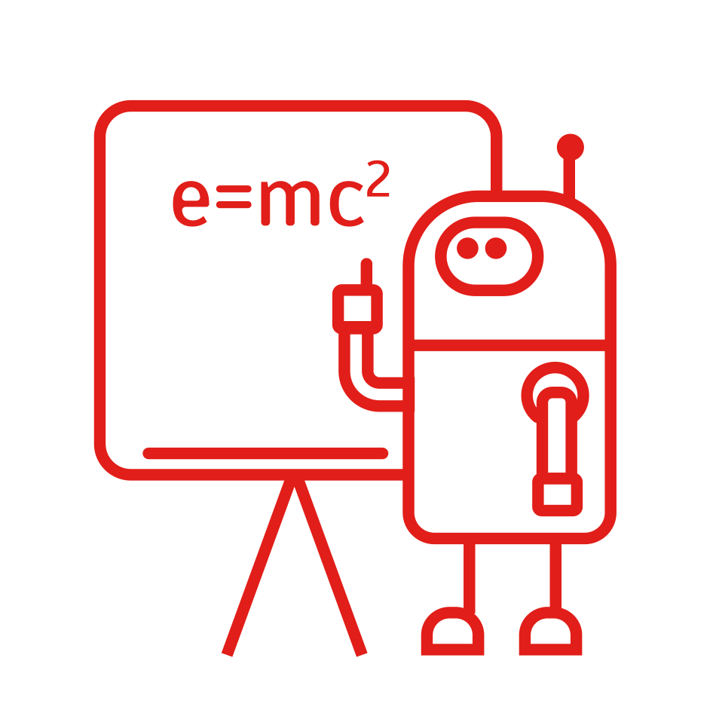
Machine learning definition
Machine learning is the ability to automatically learn and improve from experience without being explicitly programmed. focuses on the development of computer programs that can access data and use it learn for themselves.

Slide 13

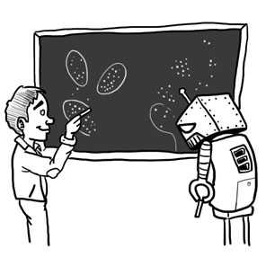
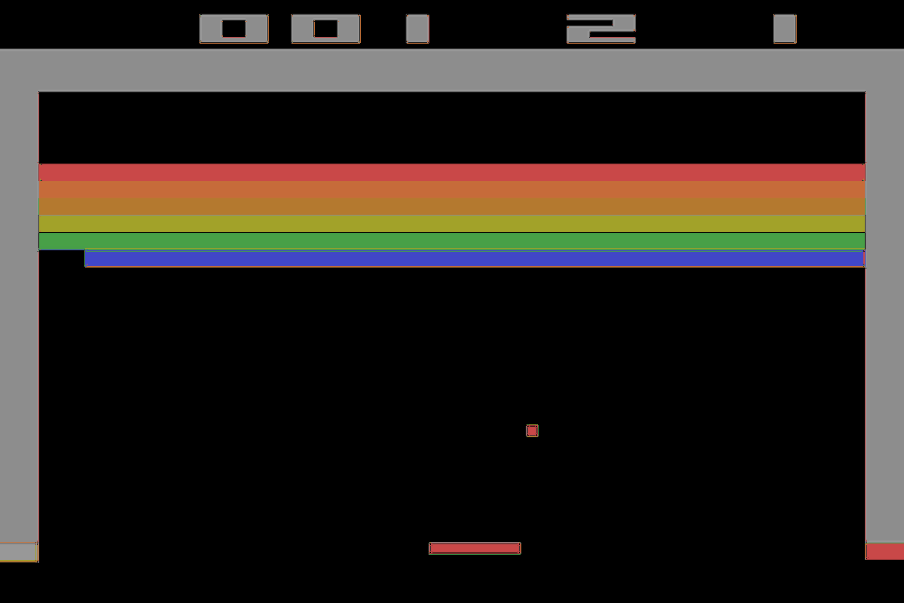
Three major types of ML
Supervised Learning (classification)
The learning process is based on labeled data (eg. object recognition on photos)
Unsupervised Learning (clastering)
Finding patterns in unlabeled data (eg. customers clustering)
Reinforcement Learning (robotics, games)
Systems learning by being reworded for reaching specific goal (eg. robot learning to walk)

Slide 14
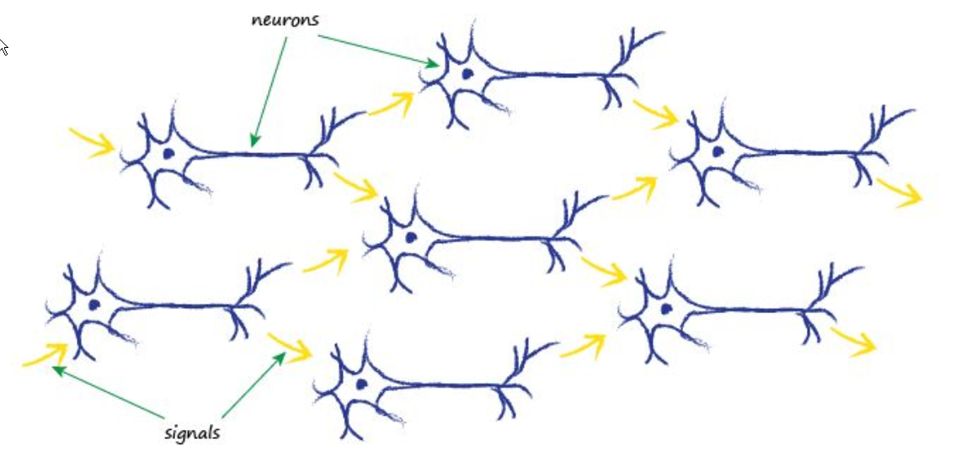
Artificial neural networks
Human brain was the main inspiration for artificial neural networks in late fifties
Currently majority of tough ML problems are solverd using neural networks
ANN were major contribution to latest progres in computer vision and natural language processing
http://neuralnetworksanddeeplearning.com/chap4.html
Notes:
Look for ‚five pairs’

Slide 15
How machine learning works?
3

Slide 16
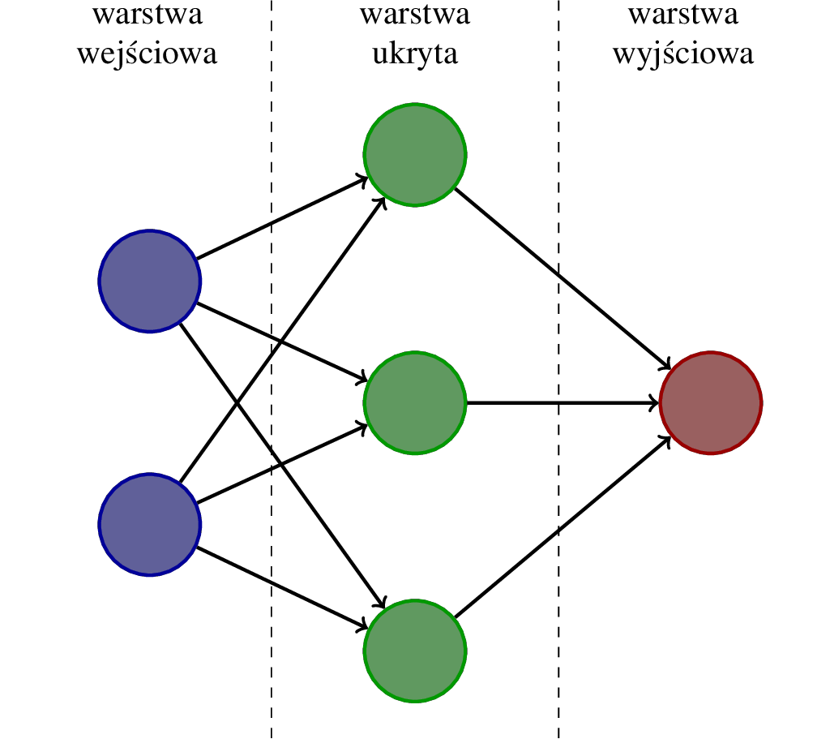

Artificial neural networks

Slide 17
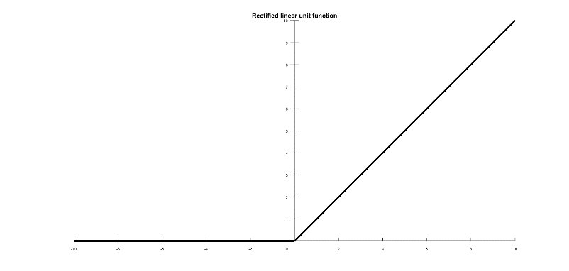
Artificial neural networks
Input layer
-0.1
1.3
Network answer
2
2
2.1
-0.3
1.1
-0.2
3
3
3.0
-2.4
-0.3
weights
Activation function

Slide 18
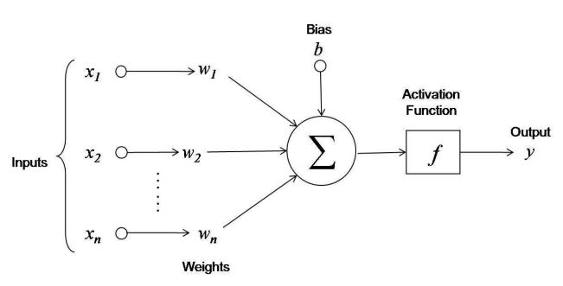
Artificial neuron

Slide 19
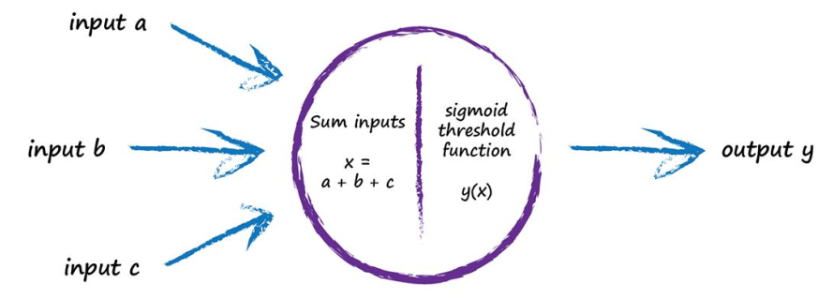
How hidden neuron works?
2
2.1
f(x)
-0.2
3
1. (input1 * weight) + (input2 * weight)
(2 * 2.1) + (3 * -0.2) = 4.2 – 0.6 = 3.6
2. activation function (reLU)
f(3.6) = 3.6

Slide 20
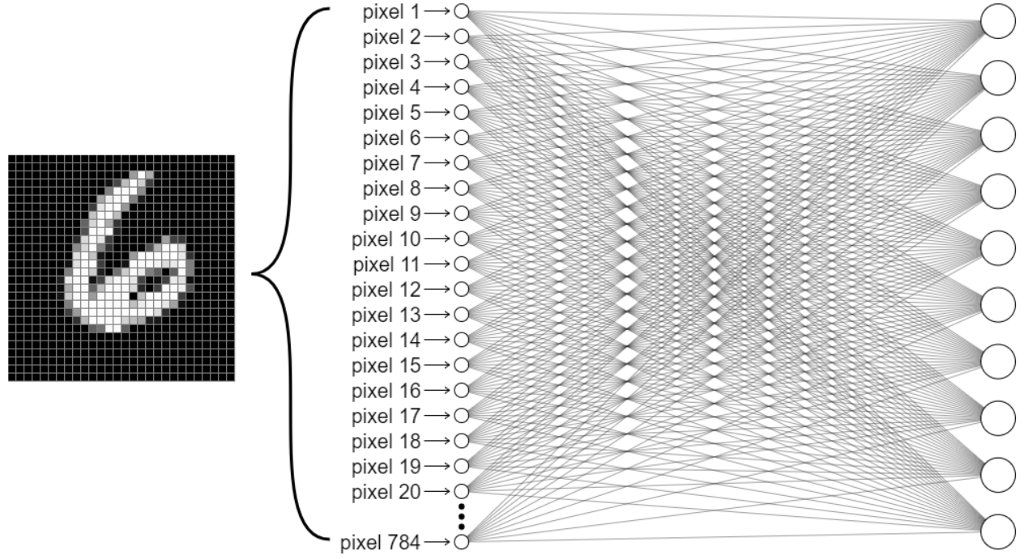
Artificial neural networks
2

Slide 21
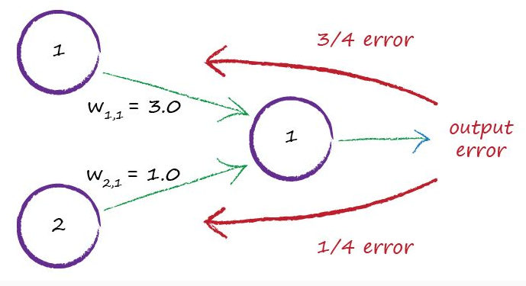
How the network learns?

Slide 22
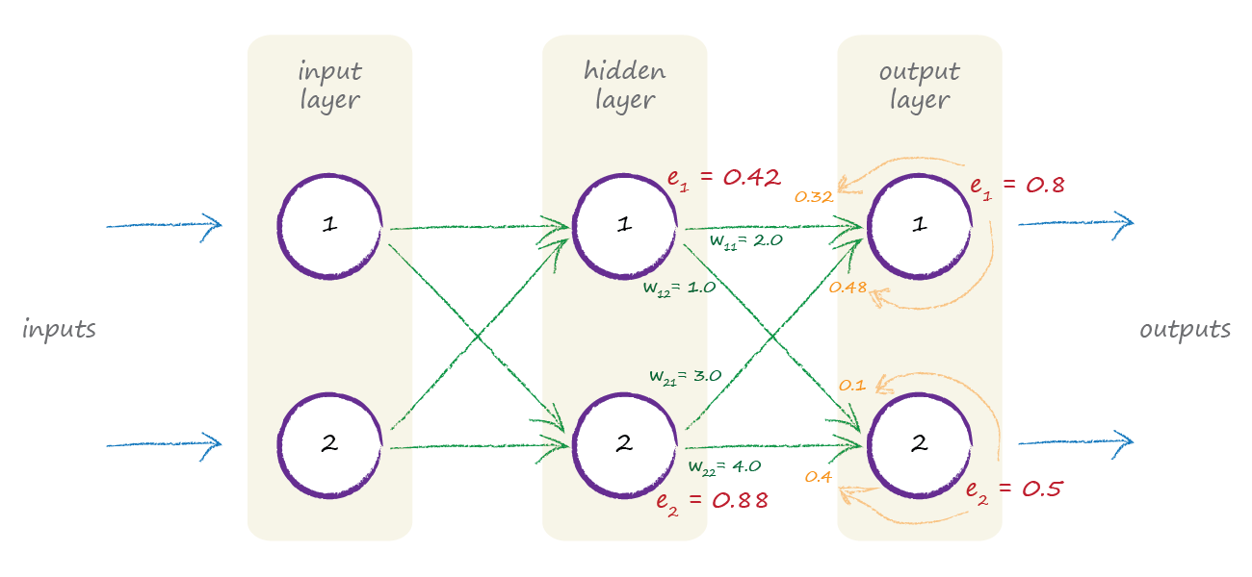
How the network learns?

Slide 23
5 epochs (250 000 digits) later
6

Slide 24
Deep learning and convNets
4

Slide 25
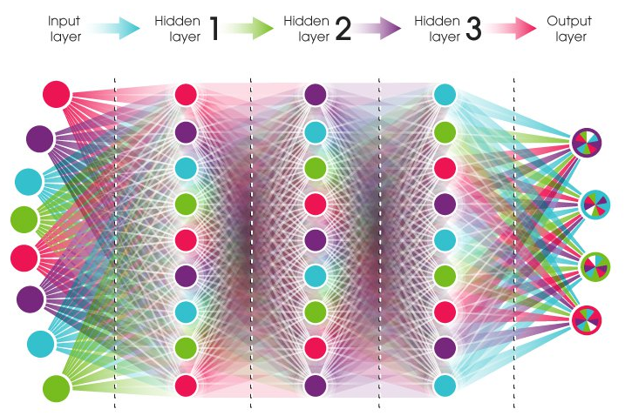
Why deep learning?
Deep learning simply means „deep neural network”, a term to describe neural networks with many layers.
Deep networks started to emarge in late 90s as a solution to computer vision problems.
They are the reason for neural networks revival after they showed their superiority in ImageNet competition 2012.
https://playground.tensorflow.org

Slide 26
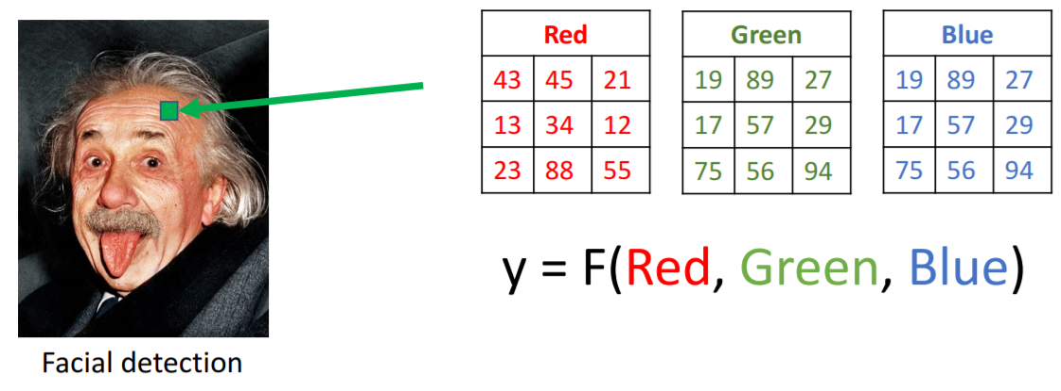
How computers see?

Slide 27
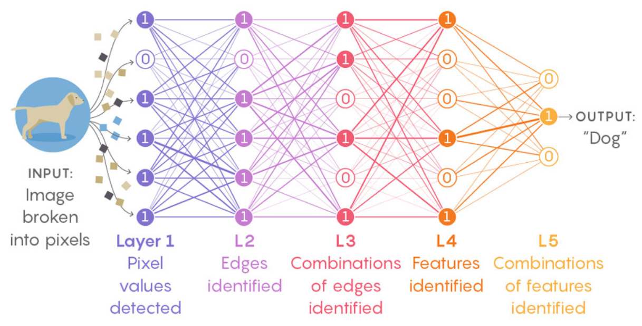
Conv what?
Convolution extract features from the input image (edges, shapes etc.) by preserving spatial relationship between pixels using small ‚filters’

Slide 28

Conv what?

Slide 29
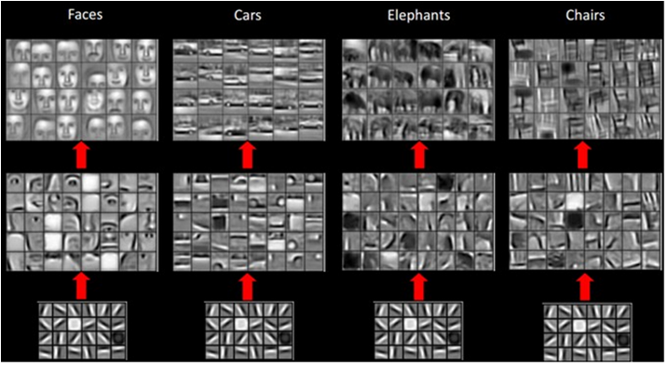
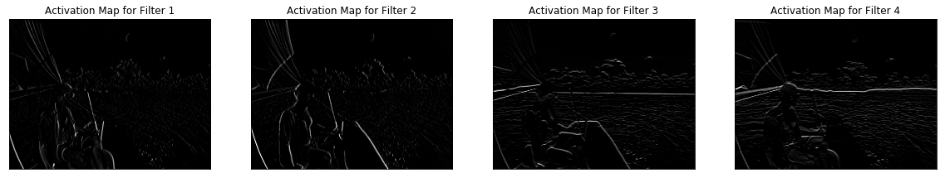
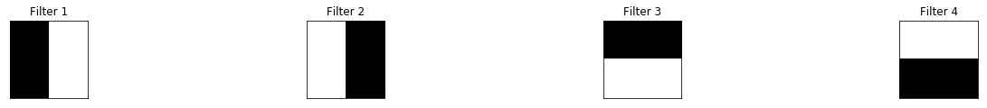
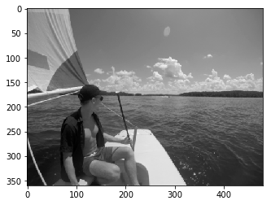
How convolution work?
http://scs.ryerson.ca/~aharley/vis/conv/
https://cs.stanford.edu/people/karpathy/convnetjs/demo/mnist.html

Slide 30
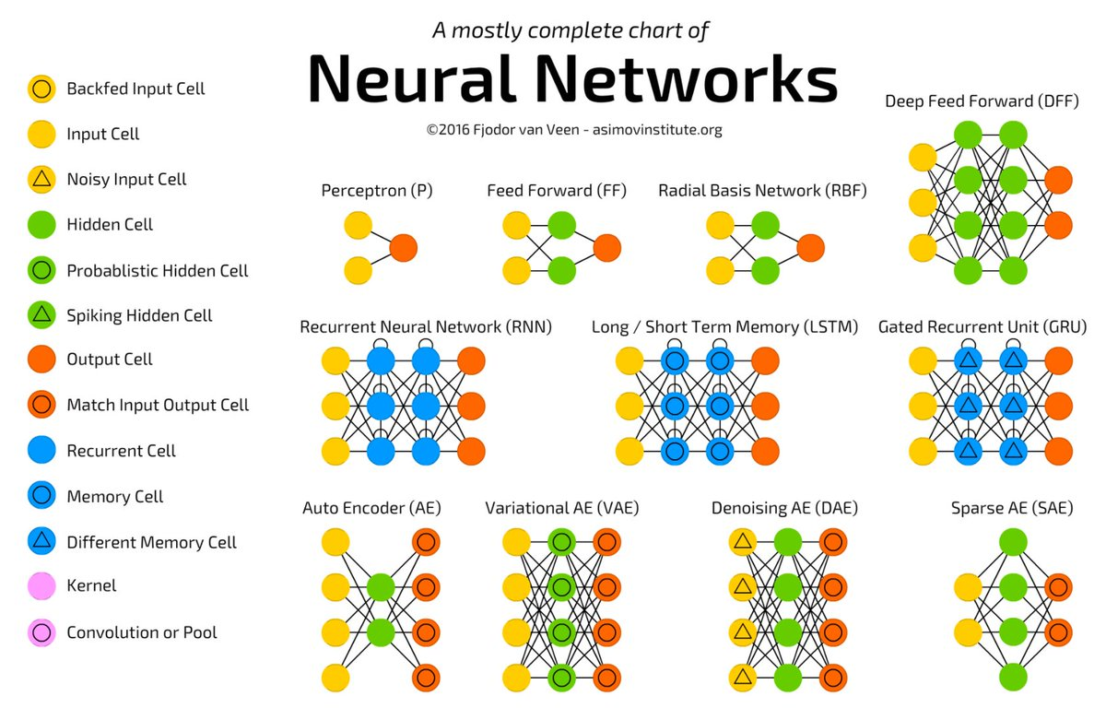
Other types of networks

Slide 31
AI in production
5

Slide 32
Training vs. inference
Training
Human
Bicycle
Forward
“Strawberry”
?
“Bicycle”
Lots of labeled data!
Backward
Error
Strawberry
Model weights
Accuracy
Inference
Forward
“Bicycle”?
??????

Slide 33
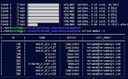
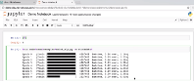





Machine learning workflow
cloud
Command Line Interface
Interactive Notebooks
User Interface
Label
Import Dataset
Build Model
Train
Deploy
Dataset
Cloud/Server
Trained Model
Edge

Slide 34








Machine Learning ZOO

Slide 35
AI at hardware level
6

Slide 36
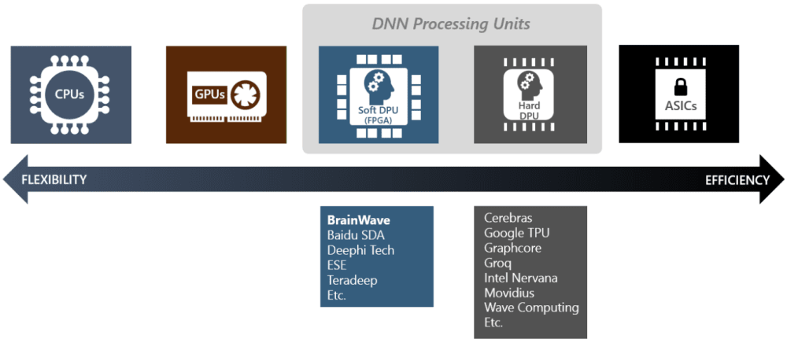
Different ways to implement ML at the hardware level

Slide 37
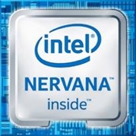







Intel AI hardware
General AI
‡
Deep Learning
Data Center/ Workstation
training
Mainstream Training
Intensive Training
Data Center/ Workstation
Mainstream AI
Mainstream Inference
Real-time Inference
inference
EDGE/ Gateway
Intel
GNA
(IP)
Flexible Acceleration
Mainstream Inference
Higher Inference Throughput
Vision 1-20W
Speech/Audio
1-100+mW
Autonomous driving
Custom
Inference

Slide 38
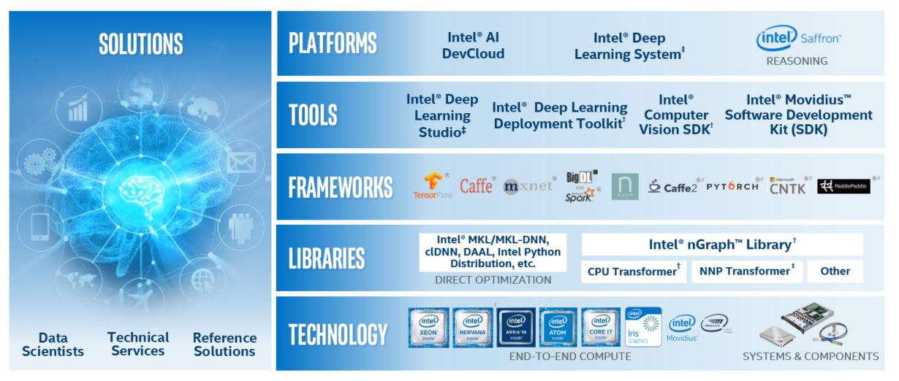
Intel contribution to AI

Slide 39
Questions?

Slide 40
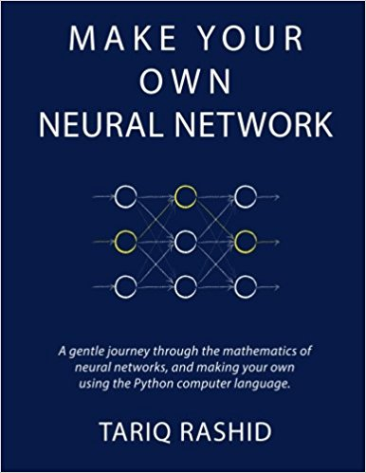
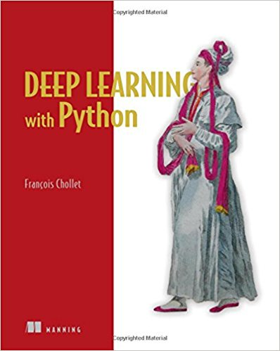

Reading materials

Slide 41

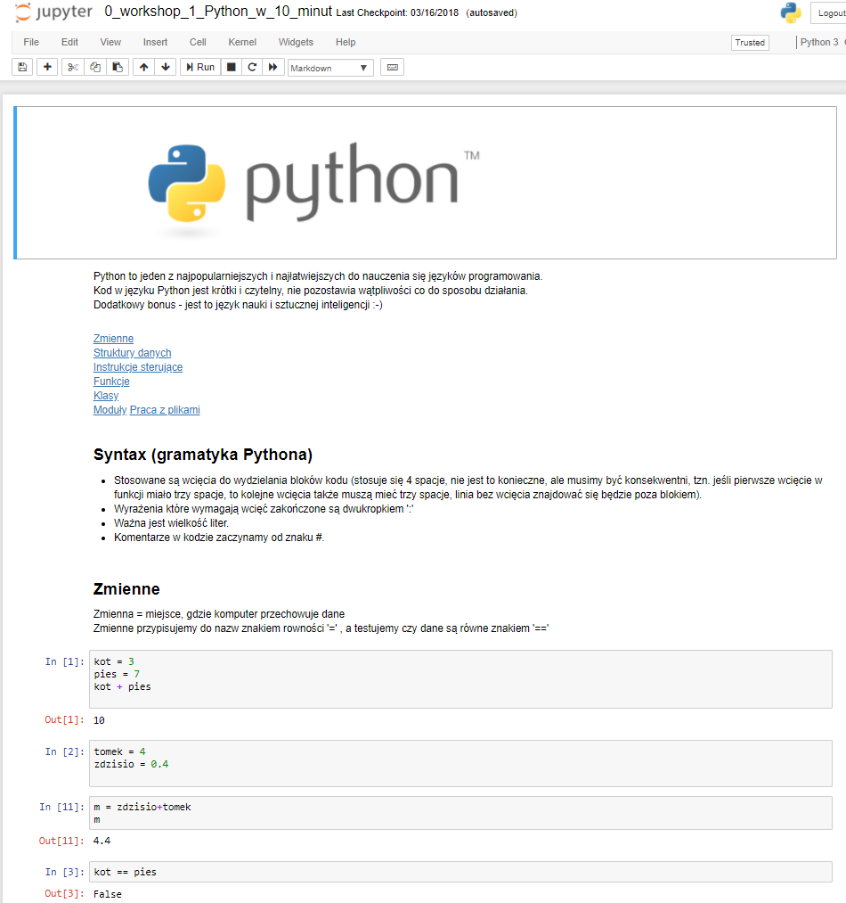
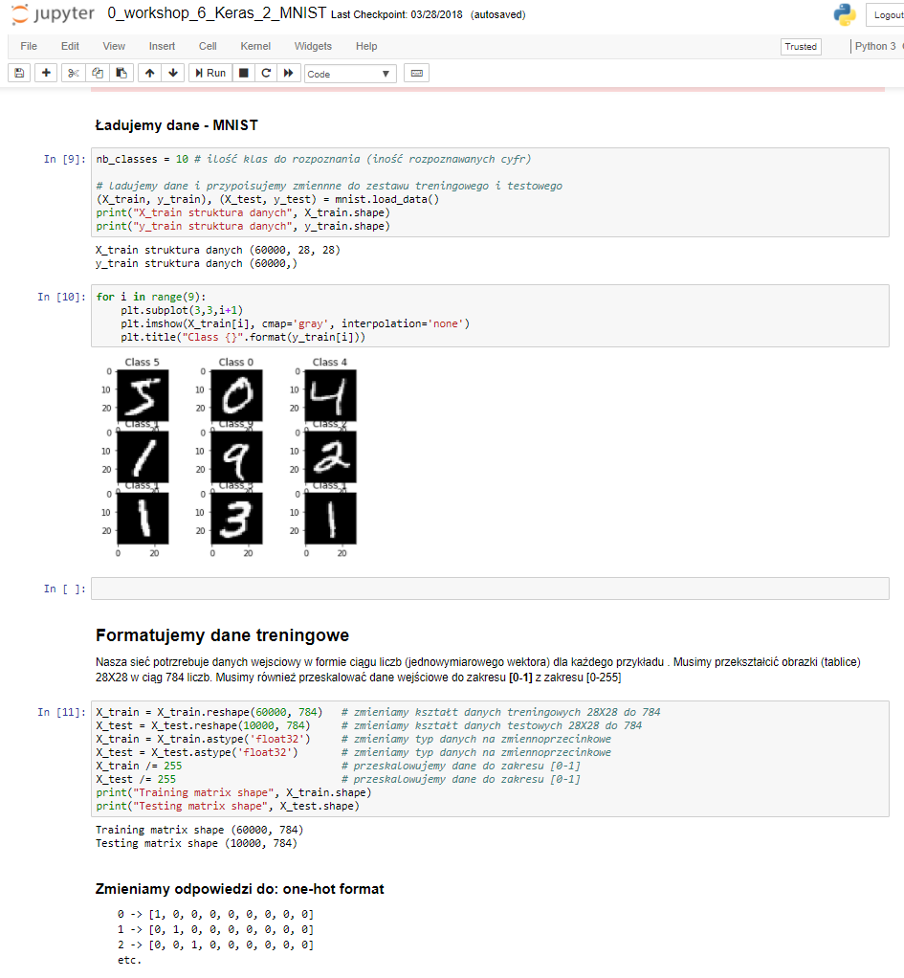
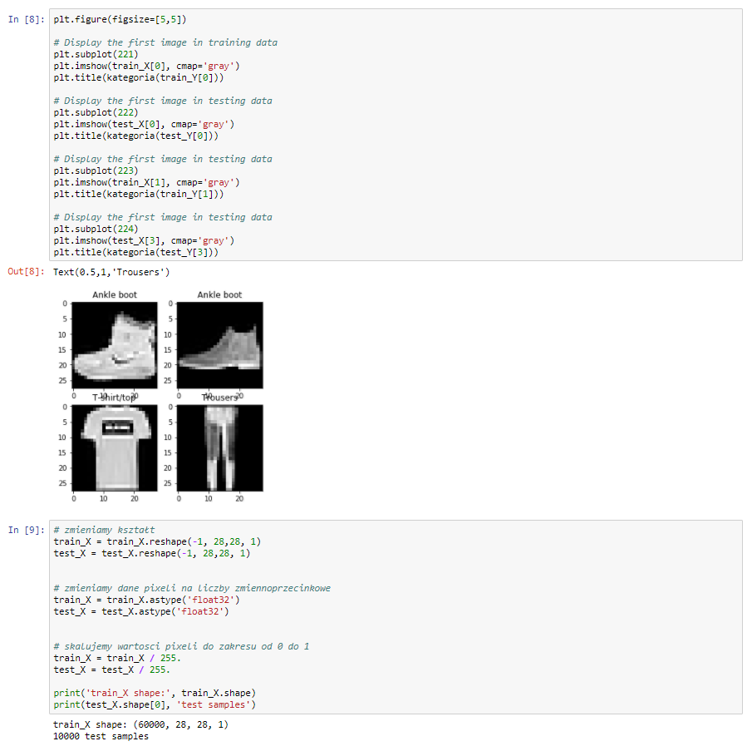
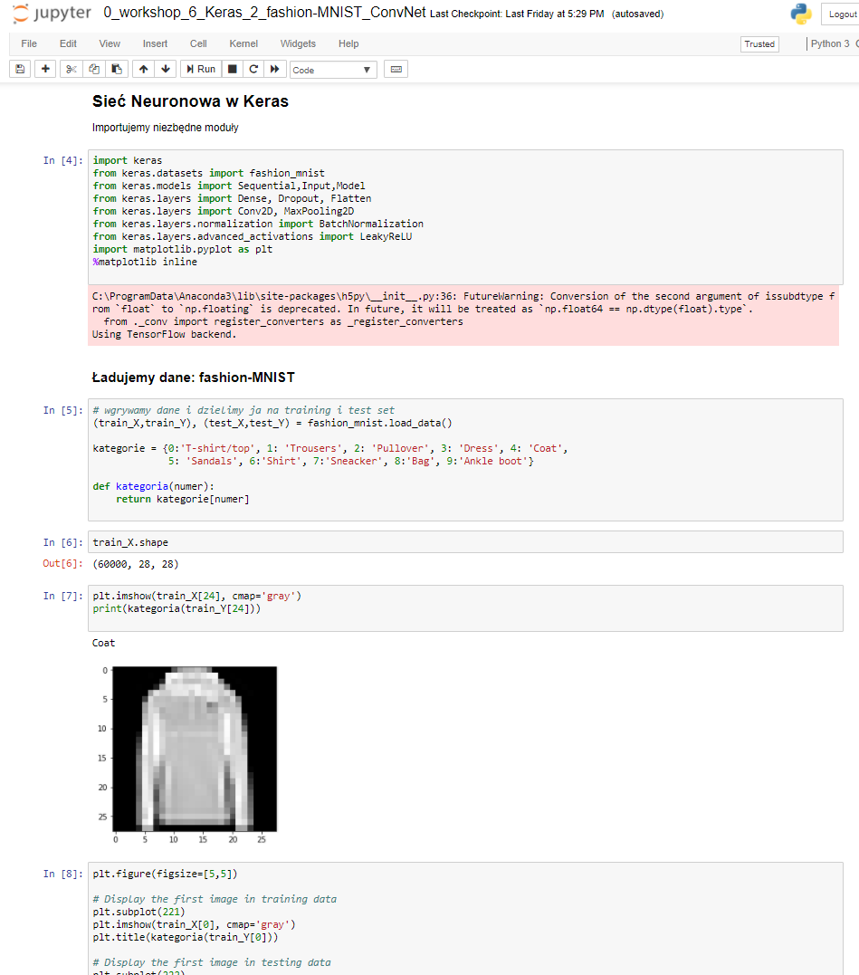
Hands on AI workshop
from print(‘hello world’) to inference in the cloud

